Slide 1
Relationships between streamflow and teleconnection patterns
By: matthew thompson

Slide 2
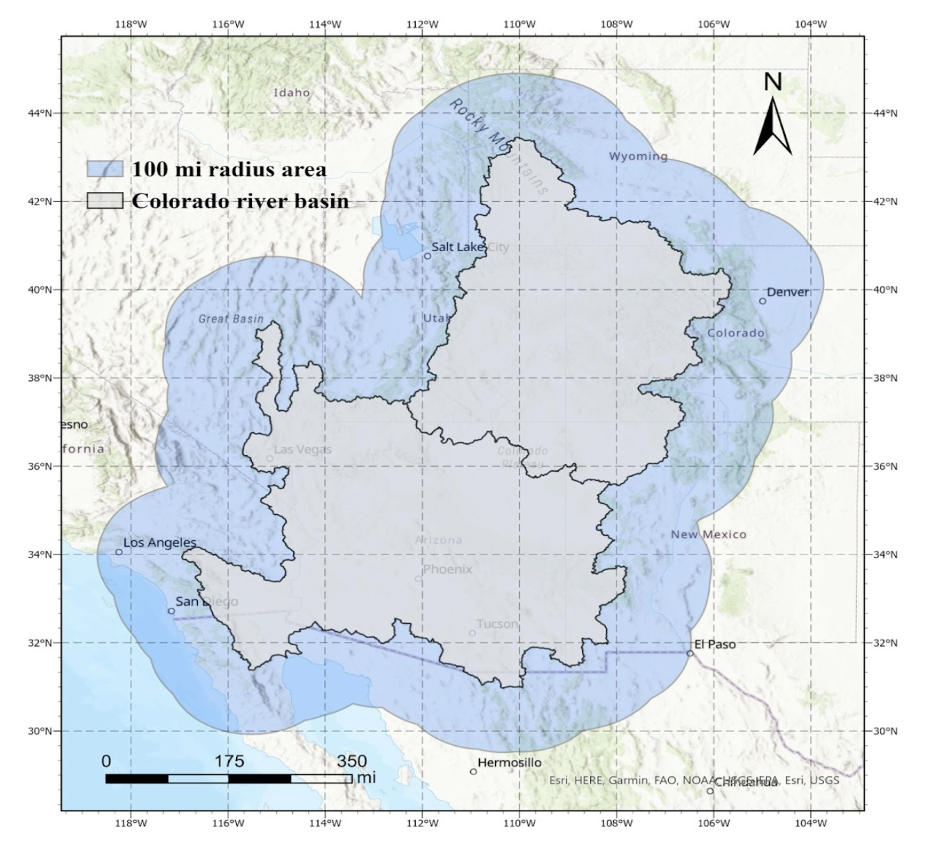
Overview
Teleconnection patterns known to impact precipitation
Do they drive streamflow?
How spatially granular is that relationship?
Notes:
recieved streamflow data from USGS collected by gauges within the Colorado River Basin
- in this case, that means would that relationship be present and potentially different regions of the CRB

Slide 3
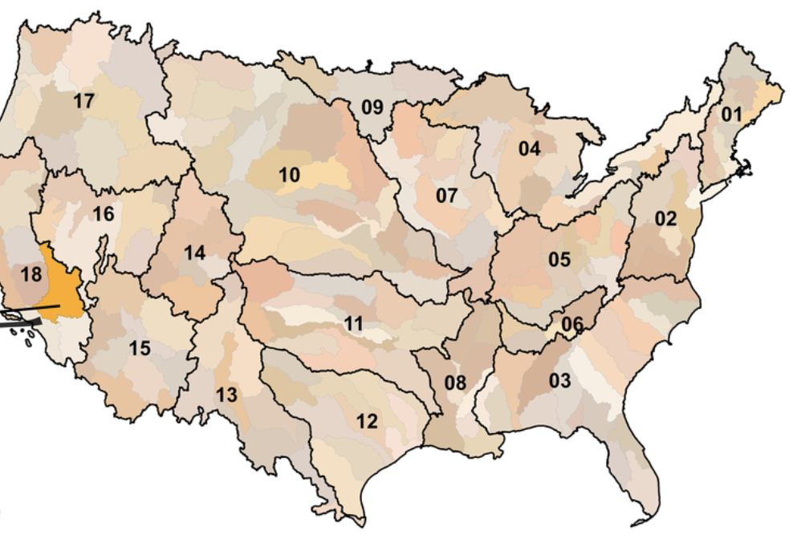
data
Streamflow percentile data
(05/01/1980 – 12/31/2016)
6 gauges, each represent region
Teleconnection data
Atlantic Multidecadal Oscillation (AMO)
El Nino–Southern Oscillation (ENSO)
Pacific Decadal Oscillation (PDO)
Pacific-North America (PNA)
number of sun spots – sun’s northern and southern hemispheres
Notes:
daily, 7-day averaged data, percentiles compared to same date for all years
- 6 datasets, ranging from SST oscillations to sun spots

Slide 4
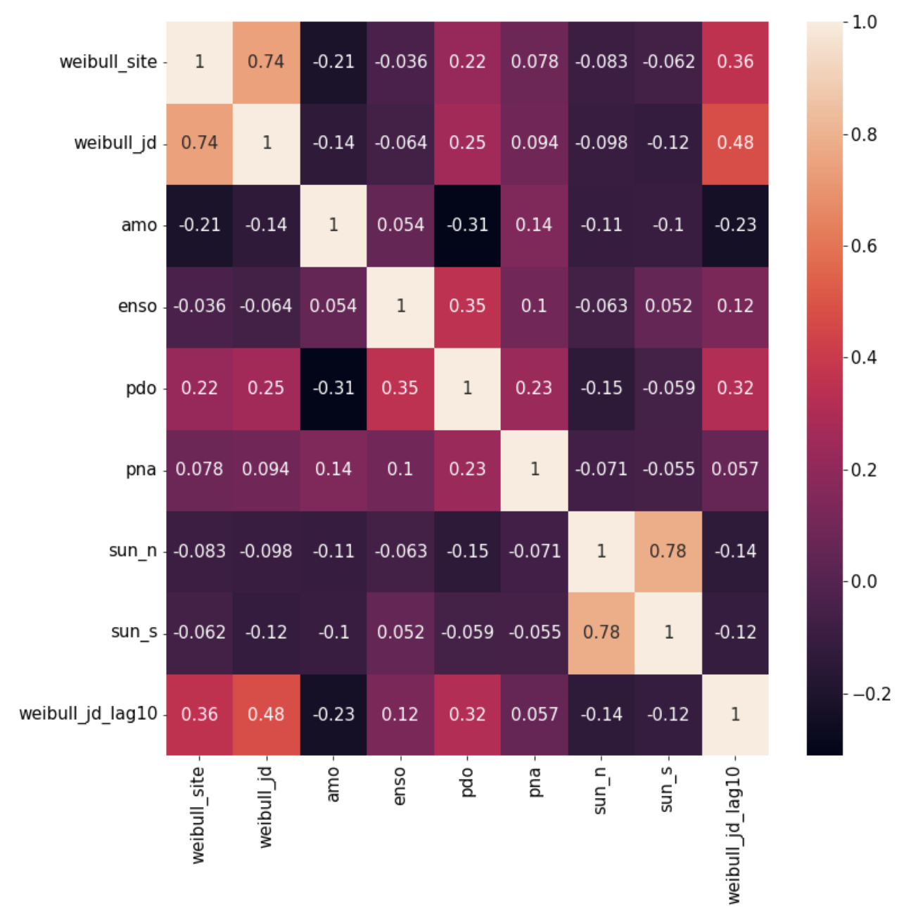
Analysis
Autocorrelation Plots
Decomposition
Spearman’s correlation/cross correlation
Continuous wavelet transformation
Wavelet coherence
Cross correlation heatmap for Lower Colorado region at 10-month lag
Notes:
seasonality and trends
- check for broad monotonic relationships between streamflow and teleconnection patterns
- better understand each datasets time series signal
- correlation between streamflow and teleconnectin patterns in time-frequency space

Slide 5
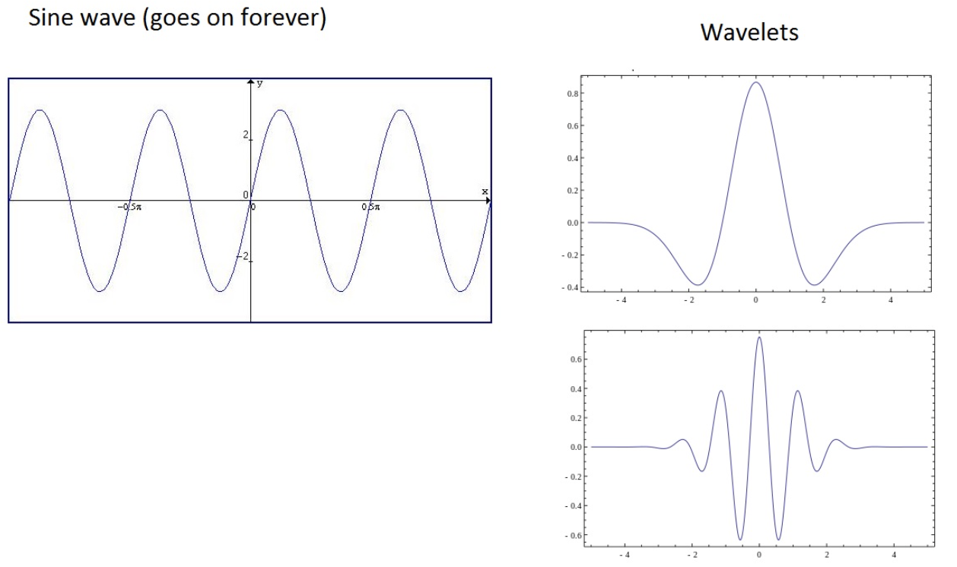
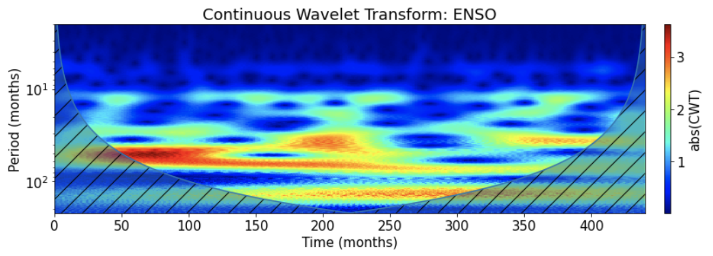
Wavelet analysis
Similar to fourier analysis
wavelets instead of sine wave
Allows for time localized signal frequency analysis
Works on non-stationary data
Notes:
use test signals of different frequencies to analyze a signal
- wavelets are self contained

Slide 6
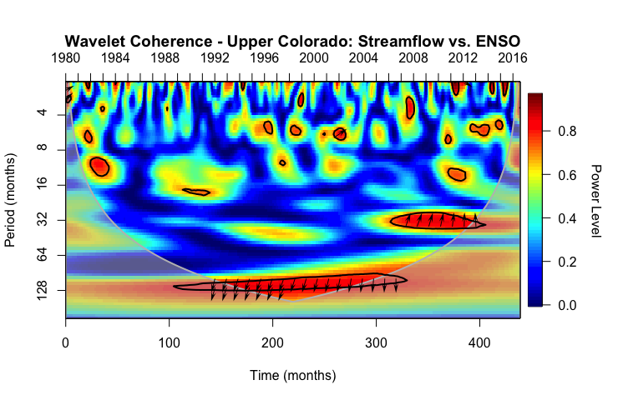
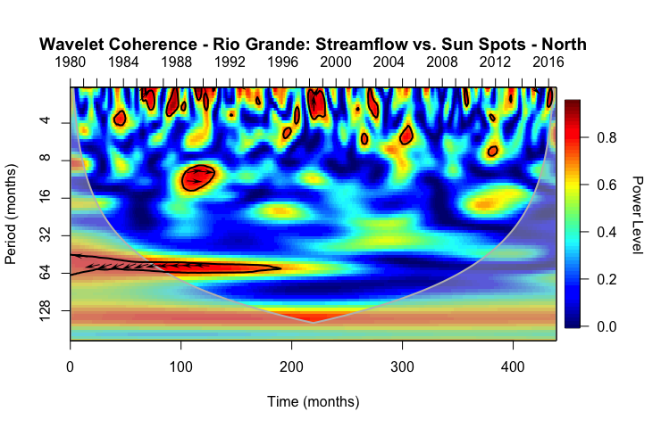
takeaways
All regions:
strong correlation to ENSO, northern sun spots, southern sun spots at period range 9-15 years
Specific regions:
Correlation w/ some patterns increases when lagged
Unique correlation along periods of 16 and 64
Notes:
period is like wavelength of value fluctuations within time series
- meaning that there are specific time windows of correlation for different region/pattern pairs
- knowing what makes each regions streamflow unique could be useful in region specfic streamflow forecaasting

Slide 7
Thank You!

